Slide 1

Handling Multivalued Dependencies in Fourth Normal Form
Database Management System | Database Design and Advanced Normalization
Course: Database Management System | Chapter: Database Design and Advanced Normalization | Program: Bachelor of Engineering
DISCOVER · LEARN · EMPOWER
Notes:
Welcome everyone to today's lecture on Fourth Normal Form. We will dive deep into handling multivalued dependencies, a critical step beyond Boyce-Codd Normal Form. This topic is essential for designing robust relational schemas that eliminate redundancy without losing data integrity.

Slide 2
Course Outcomes
SLIDE 2 / 14
Course Outcome
CO | BT LEVEL | DESCRIPTION
CO1 | BT2 | Explain database architecture, relational model concepts and formal query language foundations including relational algebra and relational calculus.
CO2 | BT3 | Apply relational algebra, relational calculus and SQL constructs to formulate correct and efficient database queries.
CO3 | BT4 | Analyze functional dependencies and design normalized relational schemas up to 5NF ensuring lossless join and dependency preservation.
CO4 | BT4 | Analyze transaction schedules and concurrency control mechanisms to determine serializability, recoverability and correctness.
CO5 | BT5 | Evaluate storage structures, indexing strategies and query optimization techniques for performance, scalability and reliability.
Chandigarh University
2 / 14
Notes:
Today's session directly addresses CO3 by teaching you how to design schemas up to 4NF and 5NF. We will analyze dependencies to ensure our designs are lossless and dependency-preserving. While CO4 focuses on transactions, understanding normalization is the foundation for correct and efficient concurrency control later.

Slide 3
Learning Objectives
SLIDE 3 / 14
Learning Outcomes
1
Define multivalued dependencies and distinguish them from functional dependencies.
2
Identify the specific conditions required for a relation to be in 4NF.
3
Apply the decomposition algorithm to eliminate multivalued dependencies effectively.
4
Analyze a real-world scenario to determine if 4NF is necessary.
5
Evaluate the trade-offs between normalization and query performance.
Chandigarh University
3 / 14
Notes:
By the end of this lecture, you will be able to define multivalued dependencies clearly. You will learn to identify when a relation violates 4NF and how to fix it. We will also practice applying the decomposition algorithm to real-world data scenarios.

Slide 4
Lecture
SLIDE 4 / 14
Understanding Multivalued Dependencies
1
A multivalued dependency X →→ Y exists if Y is independent of other attributes.
2
It implies that for a given X, the set of Y values is independent of Z values.
3
Unlike functional dependencies, one X can map to multiple independent sets of Y and Z.
4
The notation X →→ Y indicates that Y is multivalued dependent on X.
5
This dependency creates redundancy where Y and Z combinations are repeated unnecessarily.
6
It is a constraint that holds true for all possible relations satisfying the schema.
Chandigarh University
4 / 14
Notes:
Think of a multivalued dependency as two independent lists associated with a single key. For example, a professor can teach multiple courses and have multiple research interests independently. Changing a course does not affect the research interests, creating a cross-product of data.

Slide 5
Lecture
SLIDE 5 / 14
Formal Definition of MVD
FORMALLY
if t1[X] = t2[X], then there exist tuples t3 and t4 with swapped Y values.
• X →→ Y holds in R if for any two tuples with same X, their Y values can be swapped.
• The attribute set Z is defined as R - X - Y.
• The dependency implies that the values of Y are independent of the values of Z.
• This independence creates a Cartesian product of Y and Z for every unique X.
• The definition ensures that the relation remains consistent after swapping dependent values.
Chandigarh University
5 / 14
Notes:
The formal definition relies on the ability to swap Y values between tuples with the same X. If you have two professors with the same ID but different courses, you can swap their courses without violating the rule. This swapping property is the hallmark of a multivalued dependency.

Slide 6
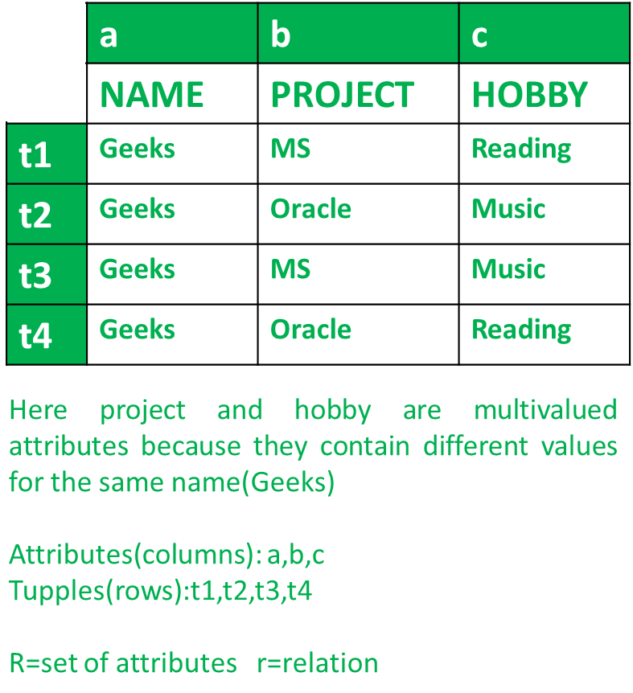
Lecture
SLIDE 6 / 14
Difference from Functional Dependency
1
Functional dependency X → Y means Y is uniquely determined by X.
2
Multivalued dependency X →→ Y allows multiple Y values for a single X.
3
Every functional dependency is a multivalued dependency, but not vice versa.
4
In FD, changing Y requires changing X; in MVD, Y and Z are independent.
5
FDs restrict the number of Y values to exactly one per X.
6
MVDs allow a set of Y values that are independent of the rest of the row.
Source: media.geeksforgeeks.org
Chandigarh University
6 / 14
Notes:
The key difference lies in uniqueness. In a functional dependency, one ID gives exactly one name. In a multivalued dependency, one ID gives a list of courses and a list of hobbies independently. If you change a course, the hobbies remain untouched, which is not true for functional dependencies.

Slide 7
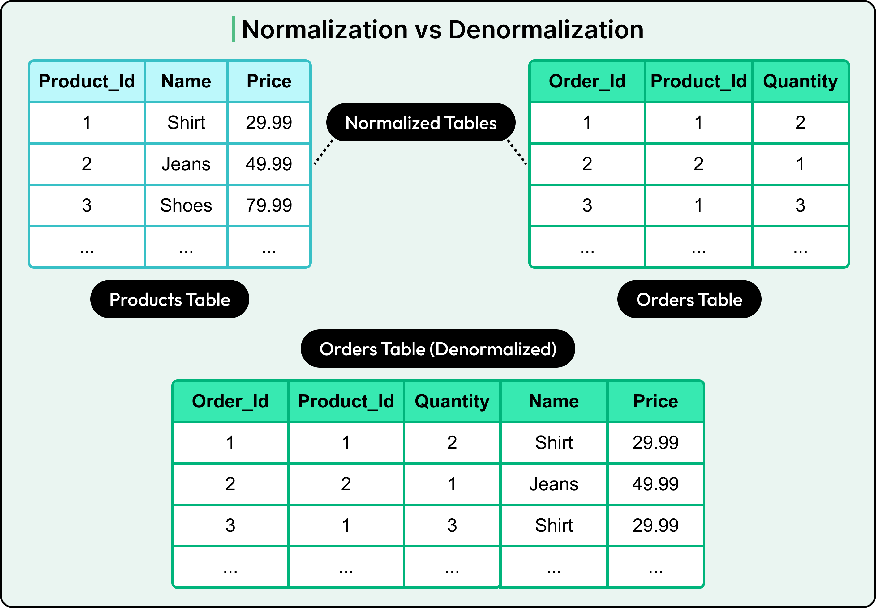
Problem
SLIDE 7 / 14
Redundancy in 3NF
1
A relation can be in 3NF but still suffer from multivalued redundancy.
2
This redundancy occurs when two independent multivalued attributes exist for a key.
3
The data repeats the combination of these attributes for every instance of the key.
4
Insertion anomalies occur when adding a new value requires adding multiple rows.
5
Deletion anomalies happen when removing a value deletes unrelated information.
6
Update anomalies arise because changing one value requires updating multiple rows.
Source: substackcdn.com
Chandigarh University
7 / 14
Notes:
Consider a table where a student has multiple courses and multiple hobbies. If a student takes three courses and has two hobbies, you get six rows. This is redundant because the course list and hobby list are independent. You cannot add a new hobby without repeating all the courses.

Slide 8
Lecture
SLIDE 8 / 14
Definition of Fourth Normal Form
FORMALLY
R is in 4NF if X →→ Y implies X is a superkey.
• A relation is in 4NF if it is in BCNF and has no non-trivial MVDs.
• This eliminates all non-trivial multivalued dependencies that are not functional dependencies.
• Every non-trivial MVD must have a determinant that is a candidate key.
• 4NF ensures that independent multivalued facts are stored in separate relations.
• It is a stronger condition than BCNF regarding independence of attributes.
Chandigarh University
8 / 14
Notes:
To be in 4NF, a relation must first be in BCNF. Then, it must not have any multivalued dependencies where the determinant is not a superkey. This means if you have an MVD, the left side must uniquely identify the entire row, effectively making it a functional dependency or a trivial dependency.

Slide 9
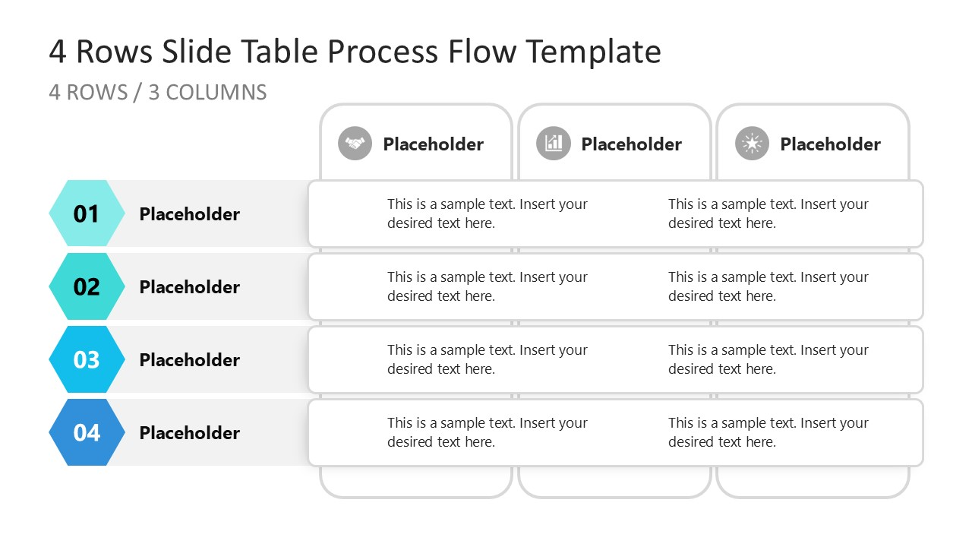
Worked Example
SLIDE 9 / 14
Student-Course-Hobby
THIS CREATES FOUR ROWS
(101, CS101, Reading), (101, CS101, Swimming), etc.
• Relation R(StudentID, Course, Hobby) with StudentID as the primary key.
• Student 101 takes CS101 and Math101, and likes Reading and Swimming.
• The dependency StudentID →→ Course and StudentID →→ Hobby exists.
• Neither Course nor Hobby is a superkey, violating 4NF.
• The data shows a Cartesian product of courses and hobbies for the student.
Source: slidemodel.com
Chandigarh University
9 / 14
Notes:
Let's look at Student 101. They take two courses and have two hobbies. This results in four rows. The dependency StudentID →→ Course exists because the courses are independent of the hobbies. Since StudentID is the key, this looks okay, but the MVDs are non-trivial and violate 4NF because the determinant is the key but the dependency is not functional.

Slide 10
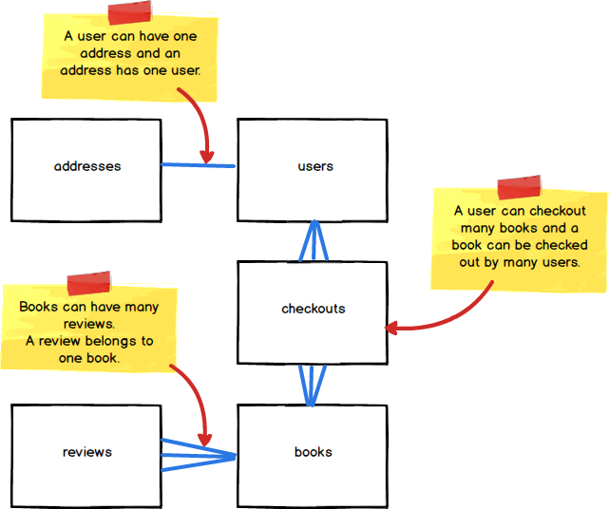
Lecture
SLIDE 10 / 14
Decomposition Algorithm for 4NF
1
Identify a non-trivial multivalued dependency X →→ Y in the relation.
2
Split the relation R into two new relations: R1(X, Y) and R2(X, Z).
3
Here Z represents all attributes in R that are not in X or Y.
4
Both new relations inherit the primary key X.
5
The join of R1 and R2 on X reconstructs the original relation losslessly.
6
Repeat the process until no non-trivial MVDs remain in any relation.
Source: d186loudes4jlv.cloudfront.net
Chandigarh University
10 / 14
Notes:
The algorithm is straightforward. You take the multivalued dependency and split the table. You create one table for the key and the first dependent attribute, and another for the key and the rest. This separation ensures that the independent lists are stored separately, eliminating the cross-product redundancy.

Slide 11
Worked Example
SLIDE 11 / 14
Decomposition Steps
1
Original R(StudentID, Course, Hobby) has MVDs StudentID →→ Course and Hobby.
2
Decompose into R1(StudentID, Course) and R2(StudentID, Hobby).
3
R1 contains pairs like (101, CS101) and (101, Math101).
4
R2 contains pairs like (101, Reading) and (101, Swimming).
5
Joining R1 and R2 on StudentID reconstructs the original four rows.
6
Both R1 and R2 are now in 4NF as they have no non-trivial MVDs.
Chandigarh University
11 / 14
Notes:
After decomposition, we have two tables. One tracks which courses a student takes, and the other tracks their hobbies. If we join them back on the student ID, we get the original data. This is a lossless join because the student ID is the common key in both tables.

Slide 12
Lecture
SLIDE 12 / 14
Common Pitfalls in 4NF
1
Confusing multivalued dependencies with functional dependencies leads to incorrect normalization.
2
Over-normalizing can degrade query performance by requiring too many joins.
3
Ignoring trivial MVDs where Y is a subset of X or X union Y is R.
4
Failing to check for transitive MVDs in complex schemas.
5
Assuming 3NF is sufficient for all real-world scenarios with independent lists.
6
Not verifying that the decomposition preserves all original data without loss.
Chandigarh University
12 / 14
Notes:
A common pitfall is assuming that 3NF is enough. If you have independent lists, you need 4NF. Another issue is over-normalization, which can make queries slow. You must balance normalization with performance. Always verify that your decomposition is lossless to avoid data loss.

Slide 13
Lecture
SLIDE 13 / 14
Key Takeaways
1
Multivalued dependencies represent independent sets of attributes for a single key.
2
4NF eliminates redundancy caused by non-trivial multivalued dependencies.
3
A relation is in 4NF if it is in BCNF and has no non-trivial MVDs.
4
Decomposition splits the relation into R1(X, Y) and R2(X, Z) for lossless join.
5
Always verify that the determinant of an MVD is a superkey for 4NF compliance.
Chandigarh University
13 / 14
Notes:
To summarize, multivalued dependencies are about independence. 4NF is the solution to the redundancy they cause. Remember the decomposition rule: split into the key plus the dependent attribute, and the key plus the rest. This ensures your database is free from these specific anomalies.

Slide 14
Lecture
SLIDE 14 / 14
References
1
Fundamentals of Database Systems — Ramez Elmasri & Shamkant B. Navathe
2
Database System Concepts — Silberschatz, Korth & Sudarshan
3
Database Management Systems — Raghu Ramakrishnan & Johannes Gehrke
4
Oracle/MySQL Documentation — Oracle
Chandigarh University
14 / 14
Notes:
These references provide the theoretical foundation for the concepts discussed today. Elmasri and Navathe offer a comprehensive view of database design. Silberschatz and Ramakrishnan provide excellent examples of normalization. Oracle documentation is useful for practical implementation.

